Slide 1
Convolutional Neural Network

Slide 2
Content
Derivation
Definition
Application
Implementation
Extension

Slide 3
Feed Forward
Back Propagation
Neural Network
Layer/Connection
Active Function

Slide 4
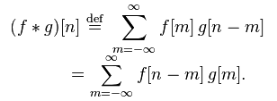

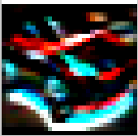

Signal
Math
Convolution
Image
Edge
Blur
-1
-2
-1
4
7
4
0
0
0
7
10
7
1
2
1
4
7
4

